Slide 1

MarketSight :
Predictive Stock Analytics
Guided By:
Dr. Vandit Hedau
Submitted By:
Sankalp Tripathi.
DS5B2327

Slide 2
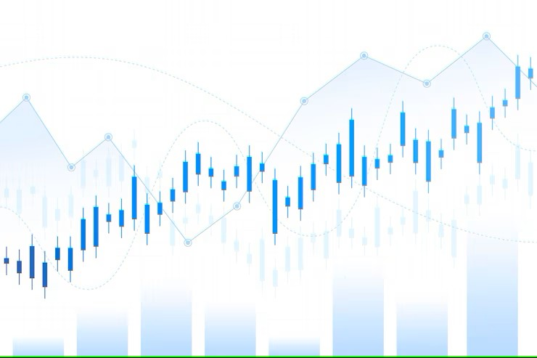
Introduction
Objective:
The main goal of this project is to build a platform that predicts future stock prices by analyzing historical data patterns.
Additionally, it evaluates the sentiment of news articles related to different companies, helping users understand the market mood before investing.

Slide 3
Key Features:
Stock Prediction using Machine Learning:
The system uses advanced ML models like Simple Moving Average (SMA), Random Forest, and Linear Regression.
It automatically selects the model with the highest accuracy to predict stock prices.
Sentiment Analysis of News:
It collects live news articles related to companies from trusted sources using an API.
Applies NLP techniques (using VADER) to classify news into Positive, Negative, or Neutral sentiments.
This analysis provides valuable insights into public perception, which often impacts stock prices.

Slide 4

Technologies Used:
Python:
Main programming language for backend and data processing.
Machine Learning (scikit-learn):
It is used to build and evaluate forecasting models.
Streamlit:
To create a modern and interactive web-based user interface.
APIs:
MarketStack API for fetching historical stock data.
World News API for retrieving recent news articles.

Slide 5

System Overview
1. User Authentication (Login/Signup):
The system provides a secure login and signup feature for users.
Usernames and passwords are stored in a CSV file.
Only authenticated users can access the forecasting and sentiment
analysis modules.
Built with Streamlit to provide a clean and user-friendly interface.
2. Stock Forecasting Module:
After logging in, users can select a company to predict its stock prices.
The module fetches historical stock data through an external API.
Applies three different ML models (SMA, Random Forest, Linear
Regression) and selects the one with the best accuracy (lowest MAPE).
Displays a graph of Actual vs Predicted values and predicts the next day's stock price.

Slide 6
3. News Sentiment Analysis Module:
Users can search for a company's name to fetch recent news
articles.
Applies Sentiment Analysis using the VADER algorithm.
Categorizes news as Positive, Negative, or Neutral.
Helps users understand market sentiment, which can influence stock
price movements.
4. Streamlit Web Interface:
Built entirely using Streamlit for ease of use and interactivity.
Sidebar navigation allows users to switch between Forecasting and
Sentiment Analysis quickly.
Responsive design with real-time feedback, making the platform intuitive
even for non-technical users.

Slide 7

Login and Signup (login.py)
Core Functionality: User login/signup and session management
Data Storage: User credentials saved in user.csv using pandas.
Signup: Collects username/password, checks for existing users, saves
new users to CSV.
Login: Validates username/password against CSV, updates session state
on success.
User Interface: Streamlit app with Login/Signup tabs, input fields, buttons,
custom styling, and logout.
Security Note: Basic implementation; passwords stored in plain text (not
secure for production).

Slide 8
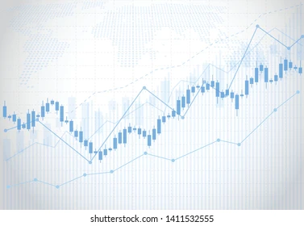
Stock Forecasting (model.py)
Purpose: Forecast stock prices using historical data and various modeling
techniques.
Data Source: Fetches End-of-Day (EOD) stock data from the Marketstack
API for selected companies.
Data Processing: Cleans and prepares fetched data, calculates an average
"Price", and creates lagged features for ML models.
Forecasting Models: Implements and compares three models:
(i) Simple Moving Average (SMA)
(ii) Random Forest Regressor
(iii) Linear Regression
Evaluation: Evaluates models based on Mean Absolute Percentage Error
(MAPE) on a test set and identifies the best-performing model.
Prediction: Retrains the best model on the full dataset and predicts the
average stock price for the next business day.
User Interface: Streamlit application allowing users to select a company,
view recent data, run models, and see results and the next
day prediction.

Slide 9
News Sentiment Analysis (news.py)
Purpose: Analyze the sentiment of news headlines for selected topics or
companies.
Data Source: Fetches news articles from the World News API based on a
user-selected topic.
Sentiment Analysis: Uses the VADER (Valence Aware Dictionary and
sEntiment Reasoner) library to calculate a sentiment compound
score for each article title.
Sentiment Labeling: Assigns a sentiment label (Positive, Negative, or
Neutral) based on the VADER compound score.
User Interface: Streamlit application allowing users to select a topic, fetch
news, and view a summary of sentiment distribution and the most
common sentiment.
API Key: Requires an API key for the World News API.

Slide 10
Frontend (main.py)
Purpose: Acts as the central hub to integrate and navigate between the
Login, Stock Forecasting, and News Sentiment features.
Structure: Uses Streamlit's session state (st.session_state) to manage
user login status and the currently displayed page.
Login/Logout: Displays the Login/Signup UI if the user is not logged in.
Provides a logout option in the sidebar when logged in.
Navigation: Uses a sidebar with radio buttons to switch between the "Stock
Forecasting" and "News Sentiment" pages after successful login.
Page Display: Instantiates and calls the build_ui method of the selected
application (StockForecastingApp or News Sentiment Analyzer
App) based on the current page state.
Background: Applies a consistent background style across all pages using
a method from the Login system.

Slide 11
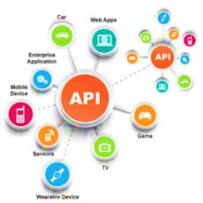
APIs Used
MarketStack API ➔ Used to fetch historical stock data, especially End-of-Day (EOD) prices. ➔ Useful for financial apps, stock market analysis, etc.
World News API ➔ Used to retrieve news articles based on specified topics, keywords, or
sources. ➔ Good for tracking news sentiment, global events, or enriching datasets
with real-world news.
VADER (Valence Aware Dictionary and sEntiment Reasoner) ➔ A lexicon and rule-based sentiment analysis tool, specifically tuned for
social media texts. ➔ Great for quickly assessing if text data (like news articles) has a positive,
negative, or neutral sentiment.

Slide 12

Results
Prediction Accuracy (MAPE): The accuracy of the model was evaluated using the Mean Absolute
Percentage Error (MAPE). The model achieved a MAPE in the range of
5% to 9%, indicating a good level of accuracy in forecasting and reliable
performance.
News Sentiment Trends: Sentiment analysis on news data revealed clear trends that aligned with
real-world events. Positive news sentiment generally preceded upward
trends in actual data, while negative sentiment corresponded with
downward movements, showing a notable correlation between sentiment
and market behavior.
Actual vs Predicted Graphs: Graphs comparing actual and predicted values were plotted to evaluate
model performance visually. The predicted values closely followed the
actual values, confirming that the model effectively captured the underlying
patterns in the data.

Slide 13

Challenges
API Data Limitations: Access to real-time and historical data via APIs was sometimes restricted
due to rate limits, missing values, or limited data availability, which
impacted the completeness and timeliness of the dataset.
Handling Insufficient Data: In several instances, the dataset lacked enough data points for certain
timeframes or events. To address this, data imputation techniques and
fallback strategies were applied to maintain continuity and model stability.
Sentiment vs Actual Market Movement Inconsistencies: Although sentiment analysis often aligned with market movements, there
were notable exceptions. Some positive or negative sentiments did not
translate into expected market behavior, highlighting the complexity and
unpredictability of real-world financial dynamics.

Slide 14

Future Scope
Integration of Deep Learning Models (LSTM, GRU): Incorporating advanced deep learning architectures like LSTM (Long
Short-Term Memory) and GRU (Gated Recurrent Unit) can enhance the
model's ability to capture long-term dependencies and improve prediction
accuracy, especially for time-series stock data.
Real-Time Stock Predictions: Expanding the system to support real-time data processing and
predictions will make the model more practical for active traders and
financial analysts, enabling timely decision-making based on current
market conditions.
Advanced Multi-language Sentiment Analysis: Enhancing sentiment analysis capabilities to support multiple languages
will broaden the data sources and improve global market insight, making
the system more robust and applicable across diverse regions and news
outlets.

Slide 15

Conclusion
Developed an integrated platform combining stock price prediction
and news sentiment analysis.
Enabled data-driven investment decisions by merging technical
and sentiment-based insights.
Achieved high prediction accuracy with MAPE between 5% to 9%.
Observed a meaningful correlation between news sentiment
trends and market behavior.
Demonstrated the potential for real-world application in financial
forecasting and decision-making.

Slide 16


